Slide 1


_
x
https://www.helloHardware.com
Hello, Hardware!
Intro to Embedded Systems
Presented by IEEE Computer Society at UCF

Slide 2
_
x
Set Up the IDE
C:\WINDOWS\system32\cmd.exe
_
x
C:\
1 Install Arduino IDE 2
2 Preferences (Mac: Settings) → Additional URLs:
https://espressif.github.io/arduino-esp32/package_esp32_index.json
3 Boards Manager → install "esp32 by Espressif"
4 Tools → Board → ESP32 Dev Module
5 Click Verify once (the first build is slow)

Slide 3
_
x
https://www.hiddenComputers.com
What Is Embedded?
Part 1 of 5 · ~10 min

Slide 4

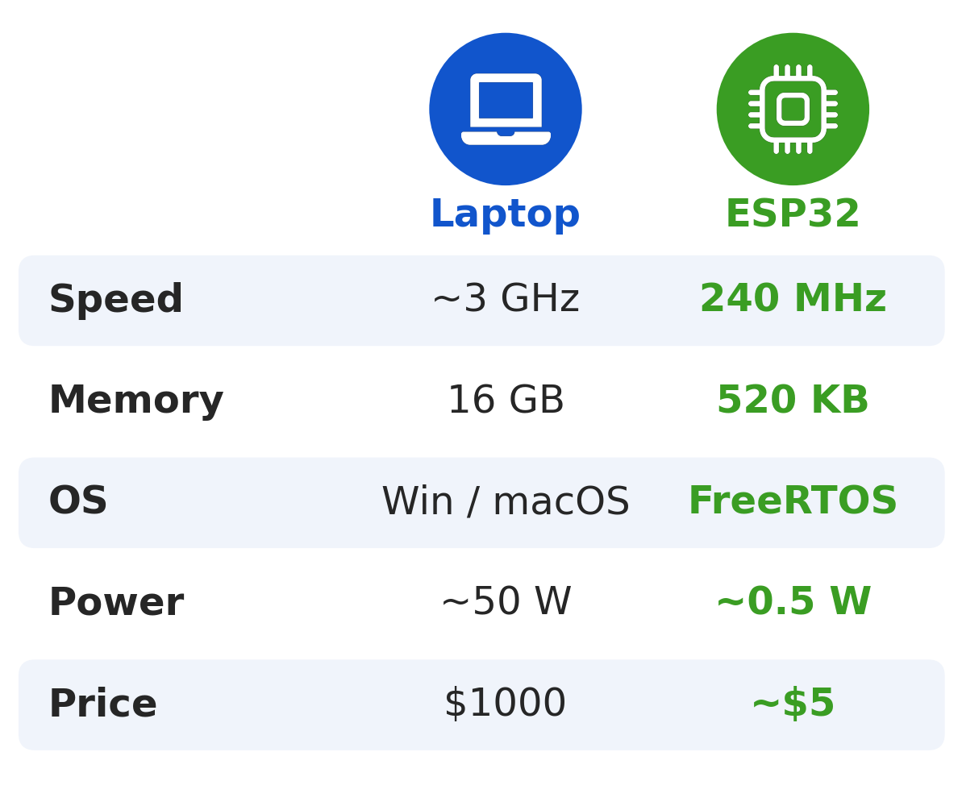
_
x
Laptop vs. ESP32
_
x
_
x
C:\WINDOWS\system32\cmd.exe
C:\
compare.bmp - Paint
Weaker, but:
> tiny
> cheap
> Low power
> Wi-Fi built in
File Edit View Image Colors Help
For Help, click Help Topics on the Help Menu.

Slide 5
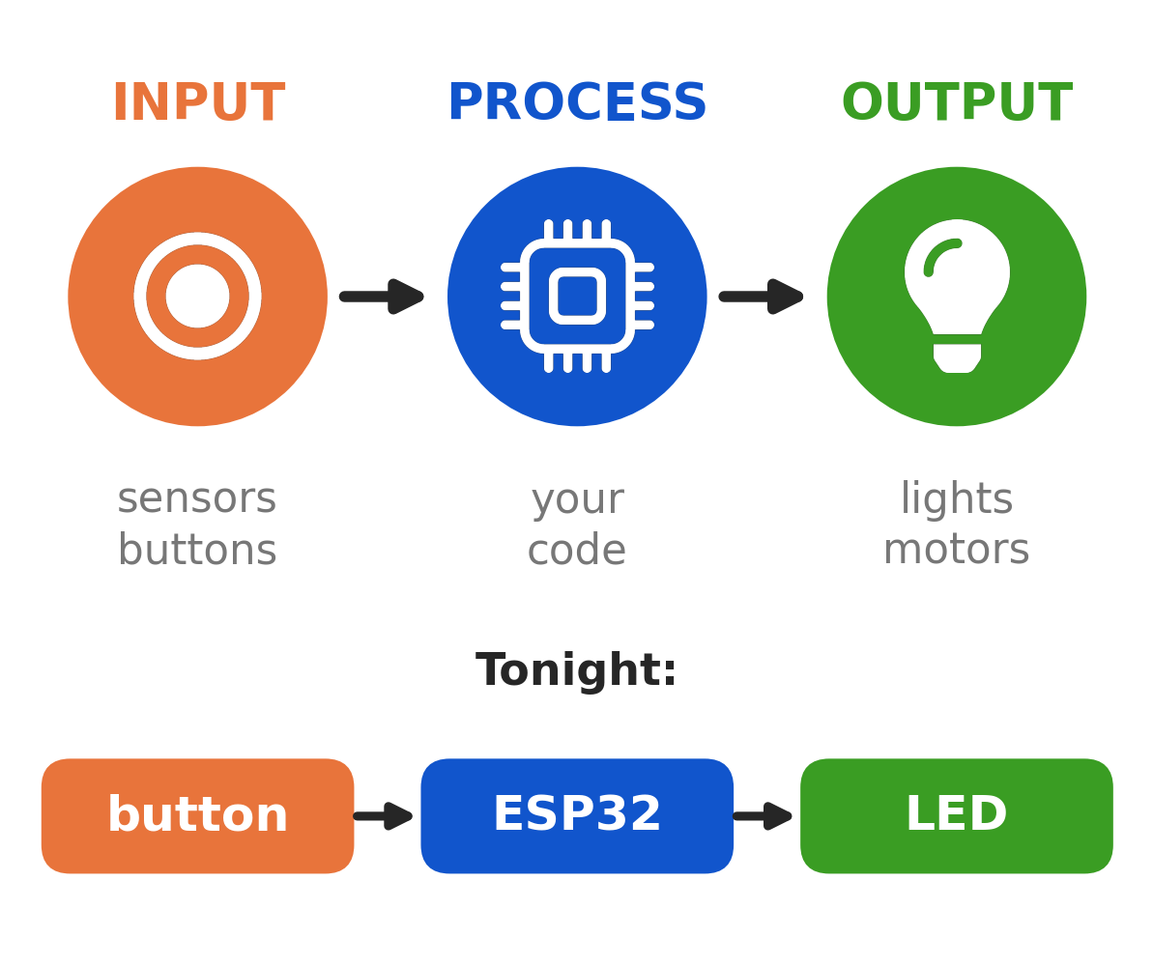
_
x
The Big Pattern
_
x
_
x
pattern.bmp - Paint
C:\WINDOWS\system32\cmd.exe
C:\
File Edit View Image Colors Help
Every embedded
system does this:
1 read inputs
2 decide
3 drive outputs
For Help, click Help Topics on the Help Menu.

Slide 6
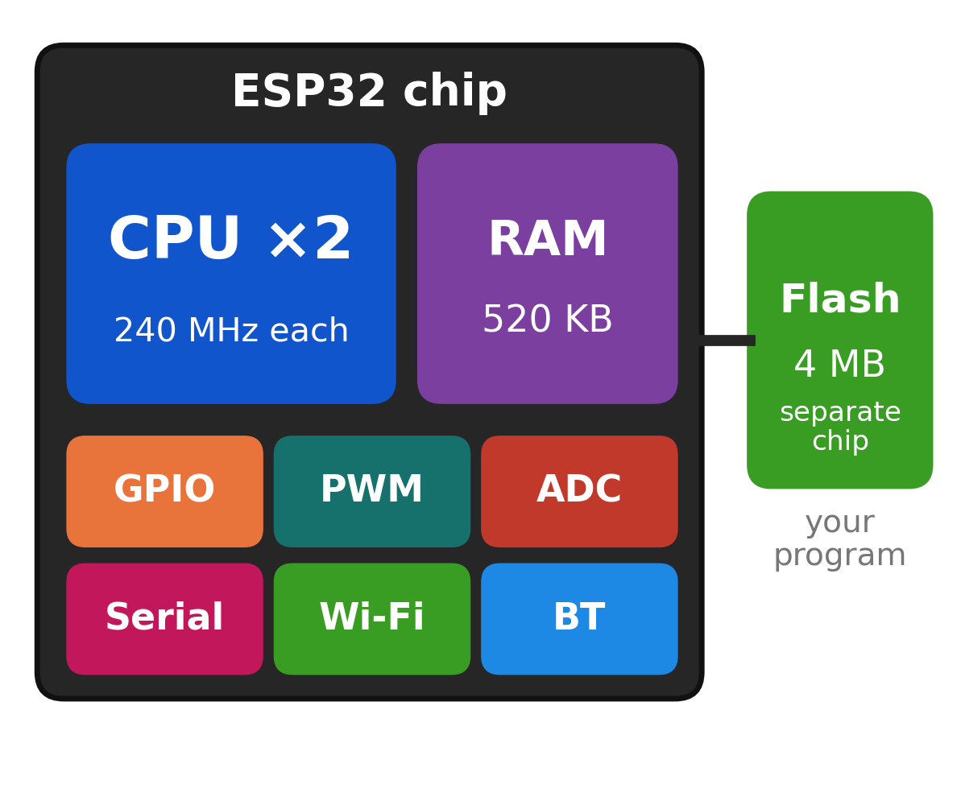
_
x
Inside the Chip
_
x
_
x
C:\WINDOWS\system32\cmd.exe
C:\
inside_esp32.bmp - Paint
A whole computer
on one chip:
> 2 CPU cores
> RAM for variables
> Wi-Fi & Bluetooth
Your program lives in
a flash chip beside it.
File Edit View Image Colors Help
For Help, click Help Topics on the Help Menu.

Slide 7
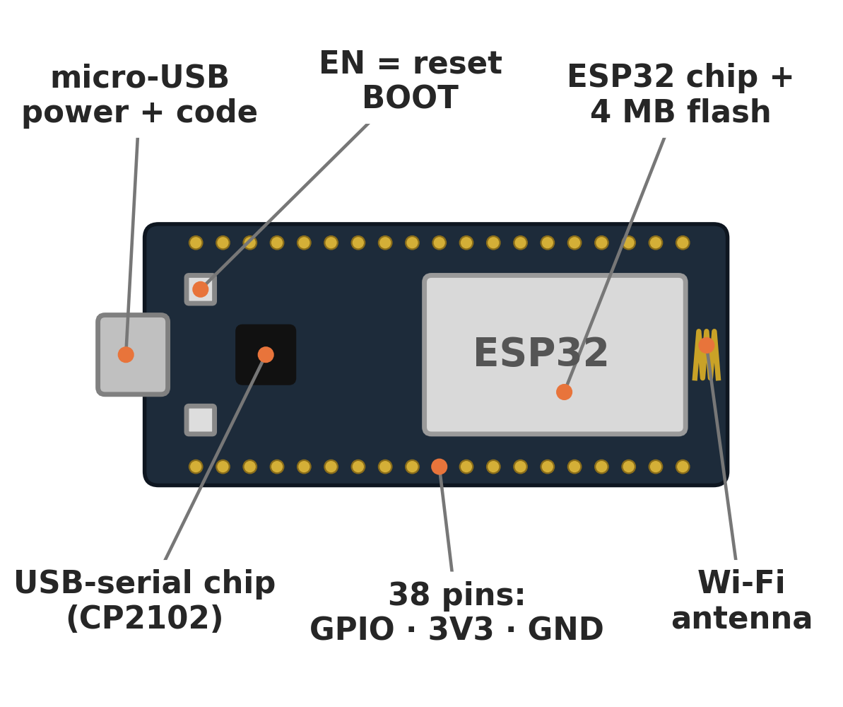
_
x
Meet the ESP32
_
x
_
x
esp32_devkit.bmp - Paint
C:\WINDOWS\system32\cmd.exe
C:\
File Edit View Image Colors Help
The dev board adds:
> USB = power + code
> EN & BOOT buttons
> Pins to wire to
For Help, click Help Topics on the Help Menu.

Slide 8
_
x
https://www.magicSmokeIsReal.com
Build It
Part 2 of 5 · ~25 min

Slide 9
_
x
Check Your Kit
C:\WINDOWS\system32\cmd.exe
_
x
C:\
[1] ESP32 board + micro-USB cable
[1] Breadboard
[1] LED
[1] 220 Ω resistor (red-red-brown)
[1] Push button
[5] Jumper wires
The USB cable must carry data, not just charge.

Slide 10
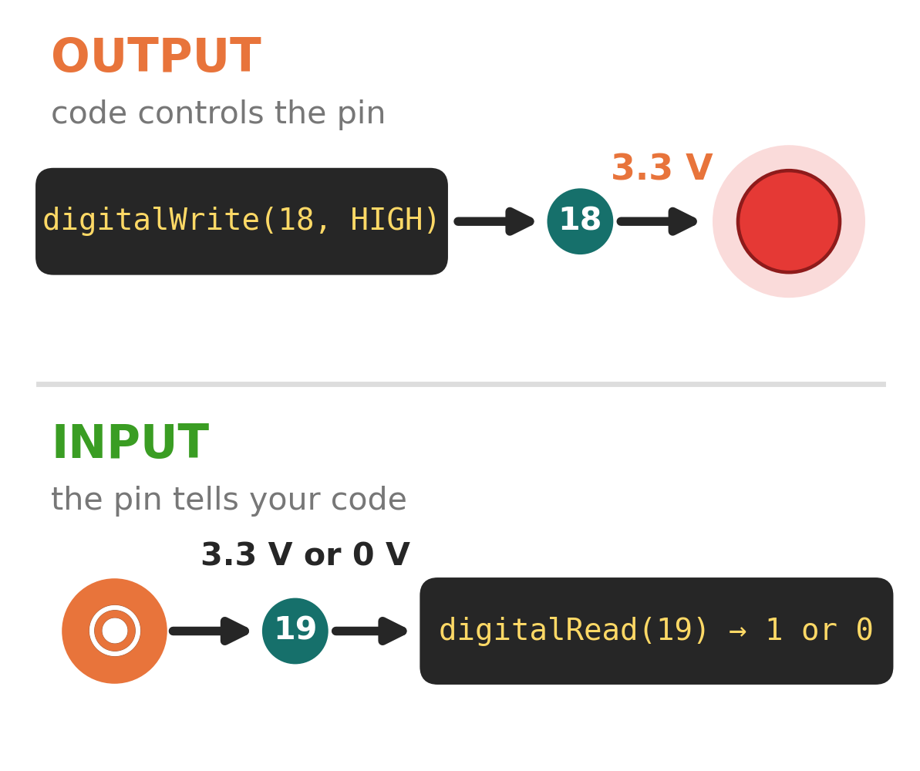
_
x
GPIO: Pins You Control
_
x
_
x
gpio.bmp - Paint
C:\WINDOWS\system32\cmd.exe
C:\
File Edit View Image Colors Help
General
Purpose
Input/
Output
OUT: sets 3.3 V / 0 V
IN: reads 1 / 0
Never put 5V on a pin.
For Help, click Help Topics on the Help Menu.

Slide 11
_
x
Not All Pins Are Equal
C:\WINDOWS\system32\cmd.exe
_
x
C:\
6–11 wired to flash: never use
(labeled CLK, CMD, SD0–SD3)
34–39 input only, no pull-up
0 2 5 12 15 affect booting: avoid
Tonight LED = G18, button = G19

Slide 12
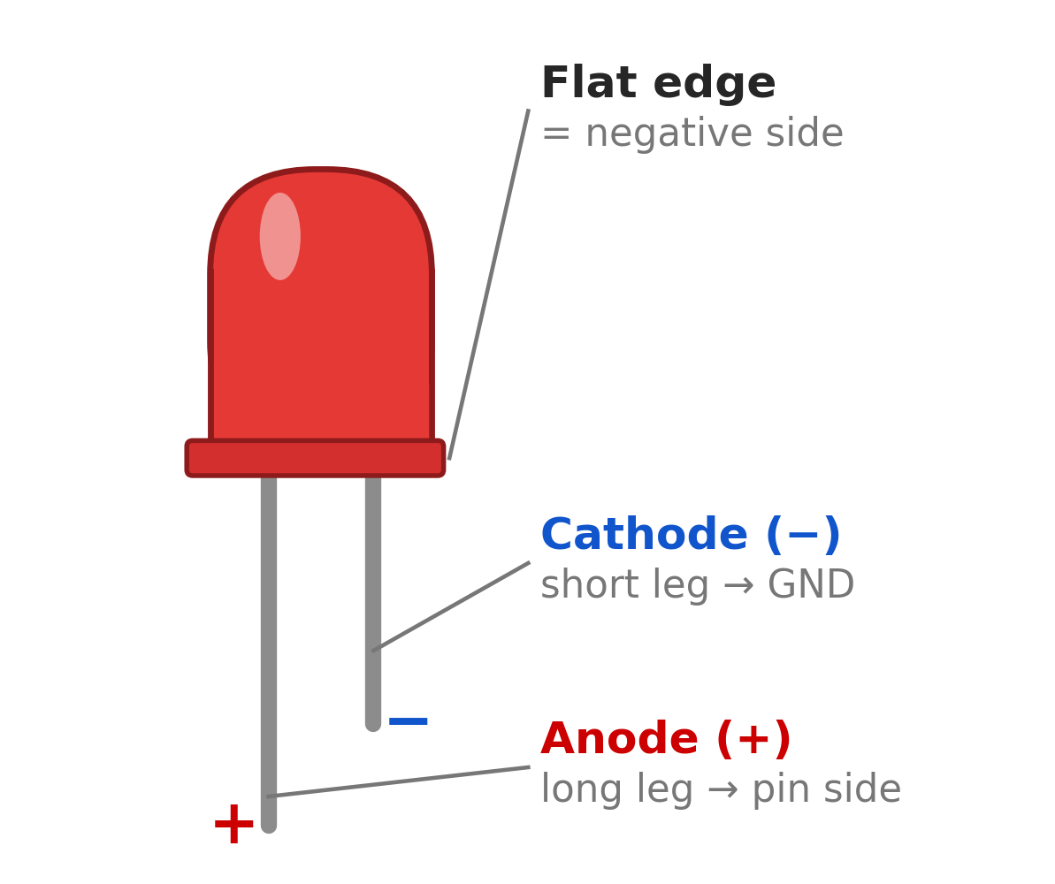
_
x
Meet the LED
_
x
_
x
C:\WINDOWS\system32\cmd.exe
C:\
led.bmp - Paint
> Works one way only
> Long leg → G18 side
> Short leg → GND
Always add the
220 Ω resistor.
File Edit View Image Colors Help
For Help, click Help Topics on the Help Menu.

Slide 13
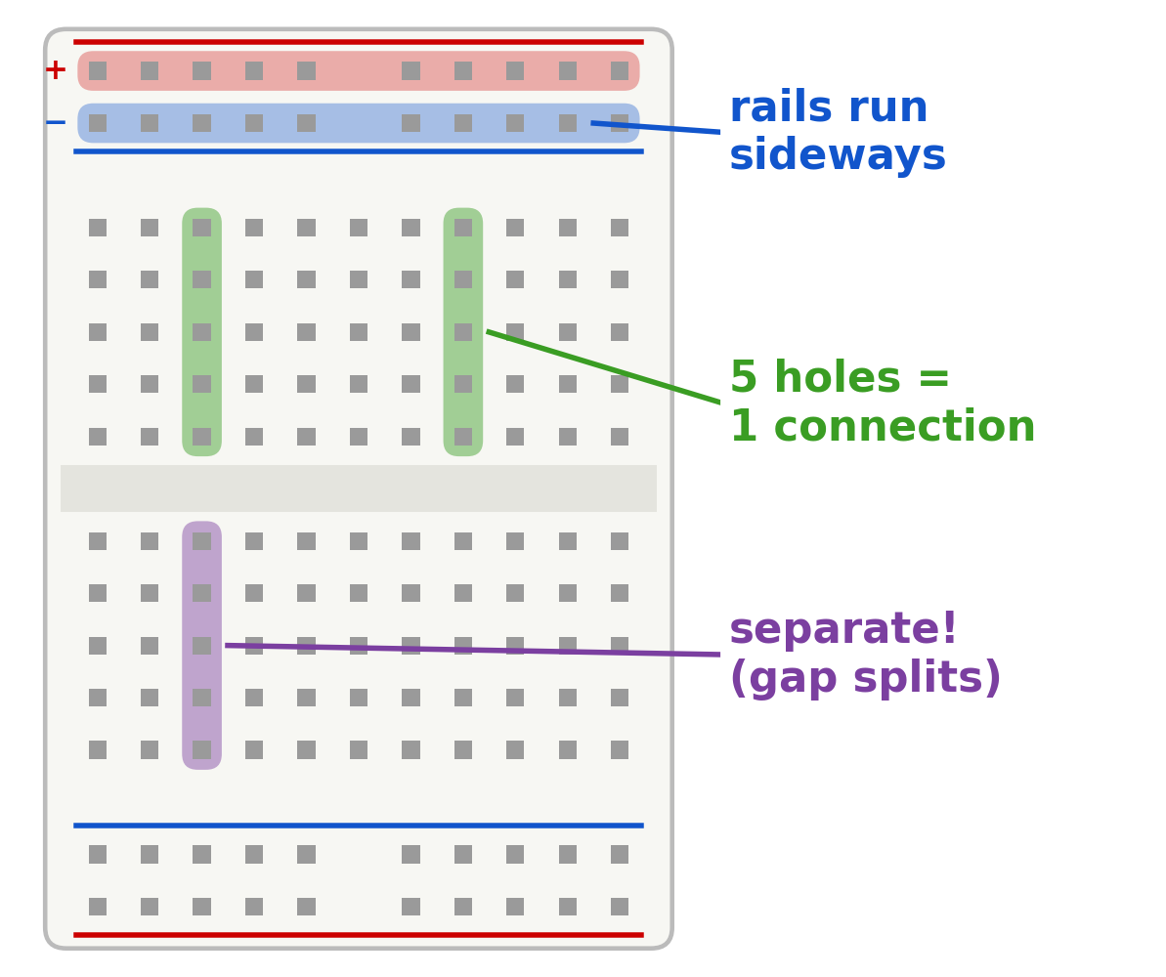
_
x
Breadboard Secrets
_
x
_
x
breadboard.bmp - Paint
C:\WINDOWS\system32\cmd.exe
C:\
File Edit View Image Colors Help
> Each column of 5
is connected
> The gap splits
top from bottom
> Rails run sideways:
shared GND
For Help, click Help Topics on the Help Menu.

Slide 14
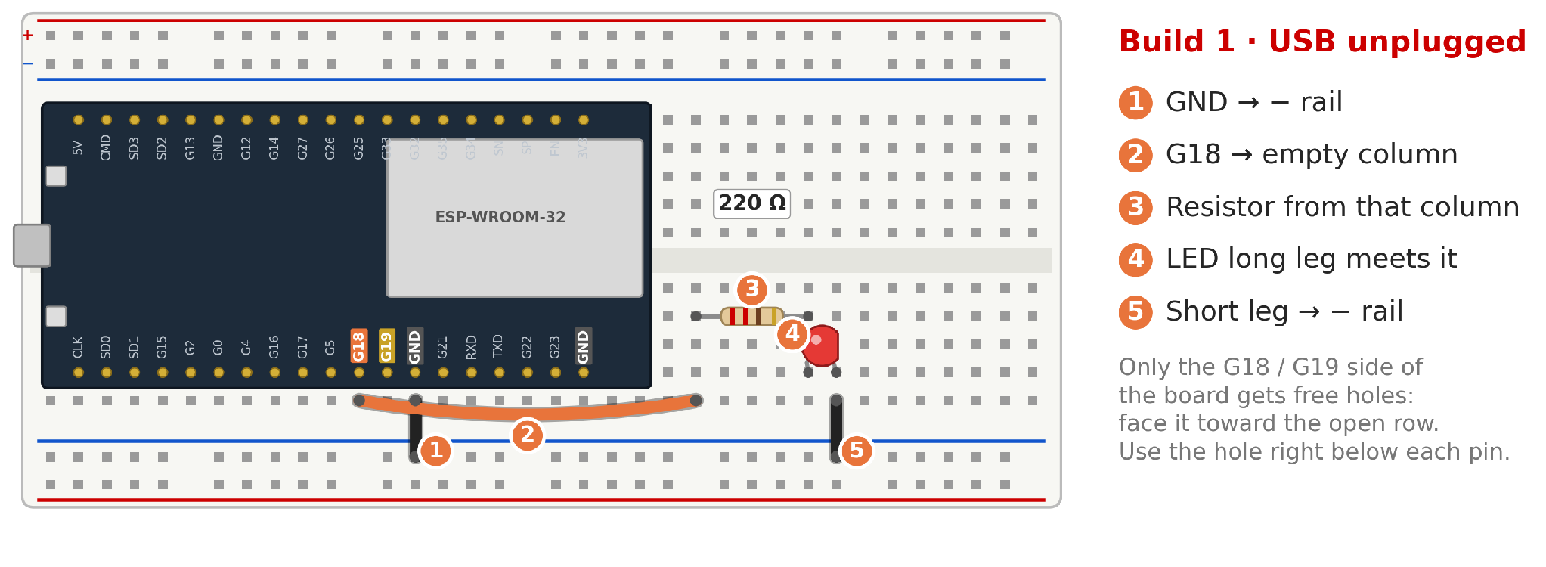
_
x
Build 1: The LED
_
x
build_1.bmp - Paint
File Edit View Image Colors Help
For Help, click Help Topics on the Help Menu.

Slide 15
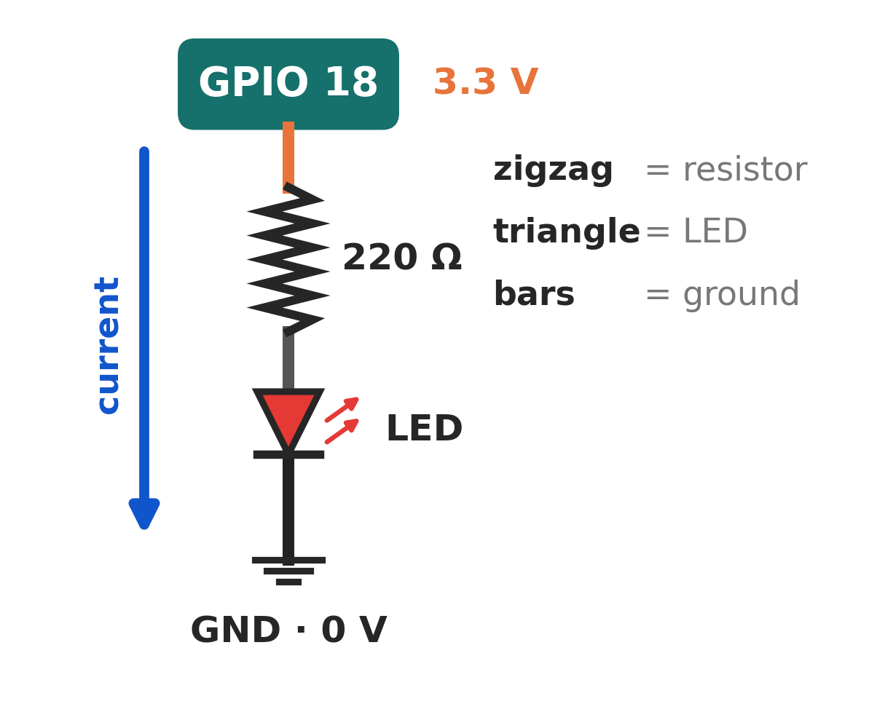
_
x
Two Ways to Draw It
_
x
_
x
C:\WINDOWS\system32\cmd.exe
C:\
schematic.bmp - Paint
Same circuit,
Schematic view.
File Edit View Image Colors Help
For Help, click Help Topics on the Help Menu.

Slide 16
_
x
Before You Plug In
C:\WINDOWS\system32\cmd.exe
_
x
C:\
[ ] Long leg on the G18 side?
[ ] Resistor in the path?
[ ] Short leg reaches GND?
[ ] Nothing in 3V3 or 5V?
All good? Plug in USB.

Slide 17
_
x
https://www.worksOnMyBoard.com
Talk to the Chip
Part 3 of 5 · ~35 min

Slide 18
_
x
Two Magic Functions
C:\WINDOWS\system32\cmd.exe
_
x
C:\
void setup() {
// runs ONCE at power-on
}
void loop() {
// runs FOREVER
}

Slide 19
_
x
Blink = Hello, World
C:\WINDOWS\system32\cmd.exe
_
x
C:\
const int LED = 18; // our pin
void setup() {
pinMode(LED, OUTPUT); // pin drives things
}
void loop() {
digitalWrite(LED, HIGH); // 3.3 V → on
delay(500); // wait 0.5 s
digitalWrite(LED, LOW); // 0 V → off
delay(500);
}

Slide 20
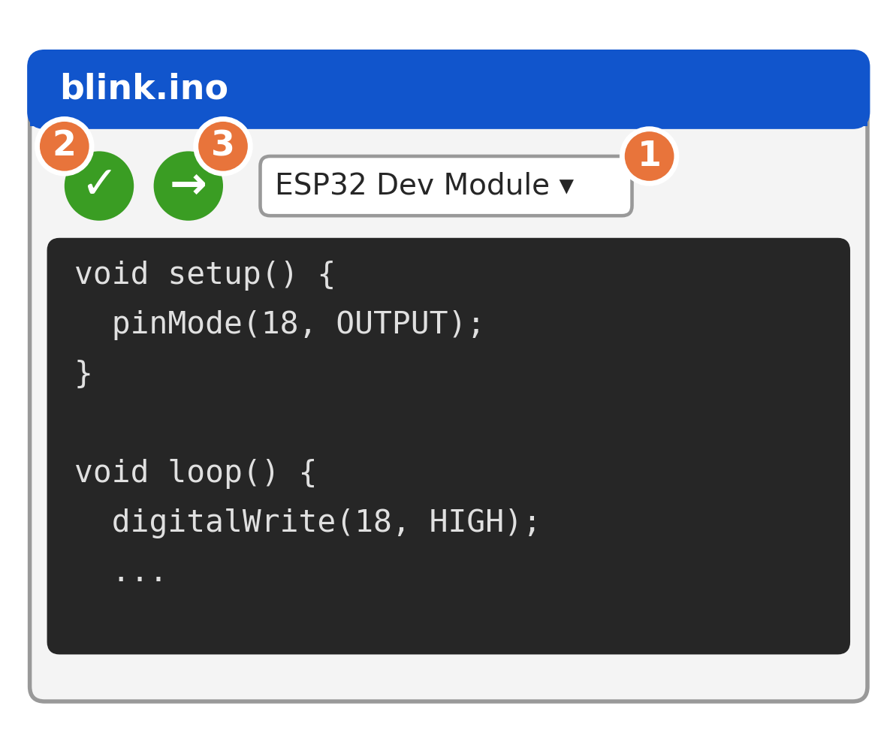
_
x
Flash It
_
x
_
x
arduino_ide.bmp - Paint
C:\WINDOWS\system32\cmd.exe
C:\
File Edit View Image Colors Help
1 Board + Port
2 Verify
3 Upload
Watch the bottom
panel: "Connecting…"
then "Writing…"
For Help, click Help Topics on the Help Menu.

Slide 21
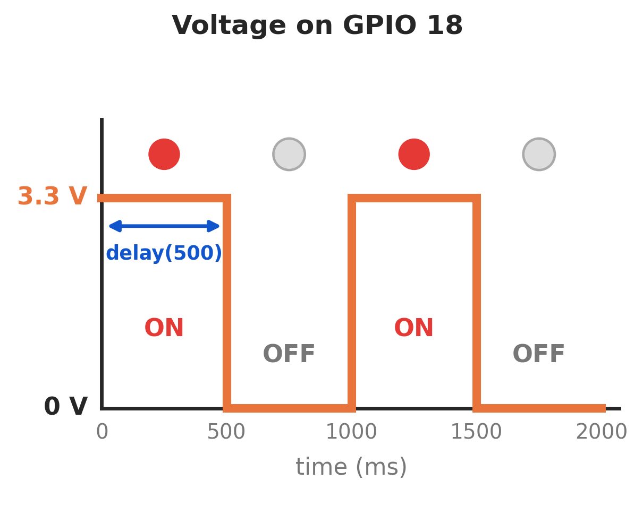
_
x
What GPIO 18 Sees
_
x
_
x
C:\WINDOWS\system32\cmd.exe
C:\
gpio18_voltage.bmp - Paint
HIGH = 3.3 V → on
LOW = 0 V → off
delay(500)
= wait 500 ms
File Edit View Image Colors Help
For Help, click Help Topics on the Help Menu.

Slide 22
_
x
Predict, Then Test
C:\WINDOWS\system32\cmd.exe
_
x
C:\
What happens if you…
1 change both delays to 100?
2 delete the LOW line?
3 change both delays to 5?
Guess first, then upload and check.

Slide 23
_
x
What Upload Does
C:\WINDOWS\system32\cmd.exe
_
x
C:\
1 Compile → .bin file (machine code)
2 esptool opens the USB port
3 Auto-reset into the ROM bootloader
4 Write bootloader, partitions & app
5 Verify the hash, reset → your code runs

Slide 24
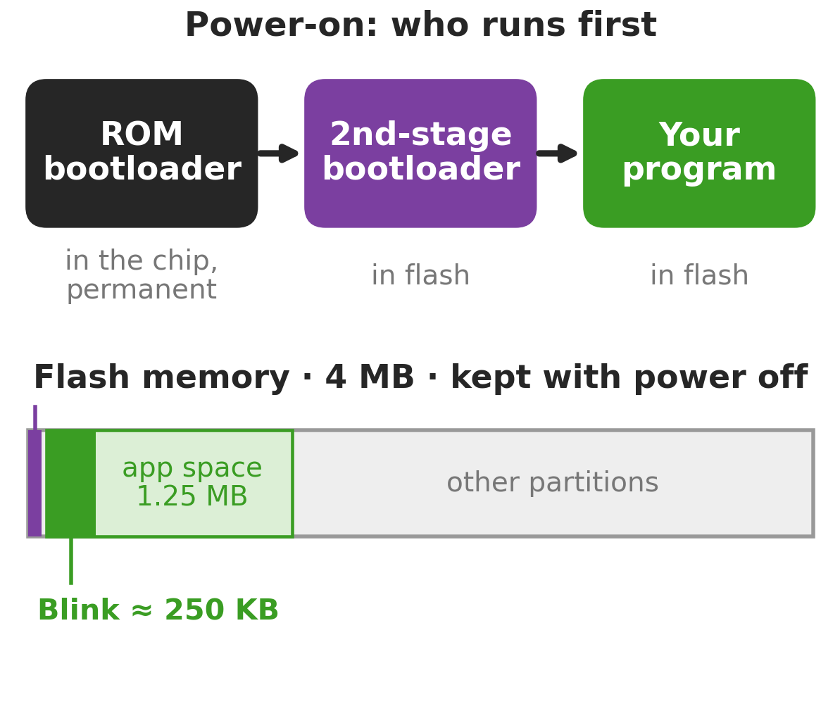
_
x
Where Your Code Lives
_
x
_
x
memory.bmp - Paint
C:\WINDOWS\system32\cmd.exe
C:\
File Edit View Image Colors Help
Flash keeps it
with power off.
Try it:
unplug, replug.
Still blinking?
For Help, click Help Topics on the Help Menu.

Slide 25
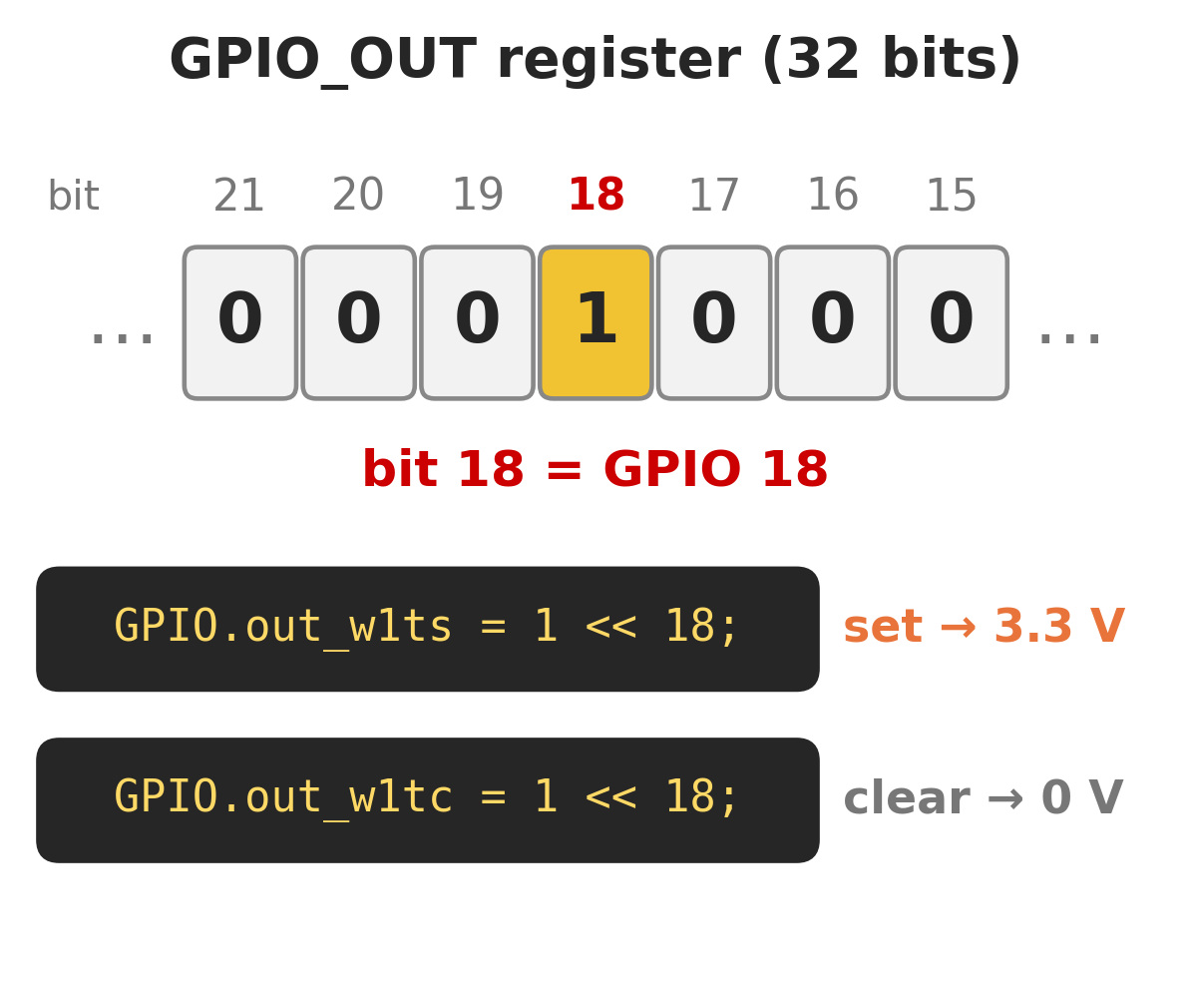
_
x
Under the Hood
_
x
_
x
C:\WINDOWS\system32\cmd.exe
C:\
gpio_out.bmp - Paint
Each pin is one bit
in a register.
GPIO 18 = bit 18
w1ts: write 1 to set
w1tc: write 1 to clear
File Edit View Image Colors Help
For Help, click Help Topics on the Help Menu.

Slide 26
_
x
Blink, Bare Metal
C:\WINDOWS\system32\cmd.exe
_
x
C:\
#include "soc/gpio_struct.h"
const int LED = 18;
void setup() {
pinMode(LED, OUTPUT); // route pin to GPIO
}
void loop() {
GPIO.out_w1ts = (1 << LED); // set bit → 3.3 V
delay(500);
GPIO.out_w1tc = (1 << LED); // clear bit → 0 V
delay(500);
}

Slide 27
_
x
https://www.pushMyButtons.com
Add an Input
Part 4 of 5 · ~20 min

Slide 28
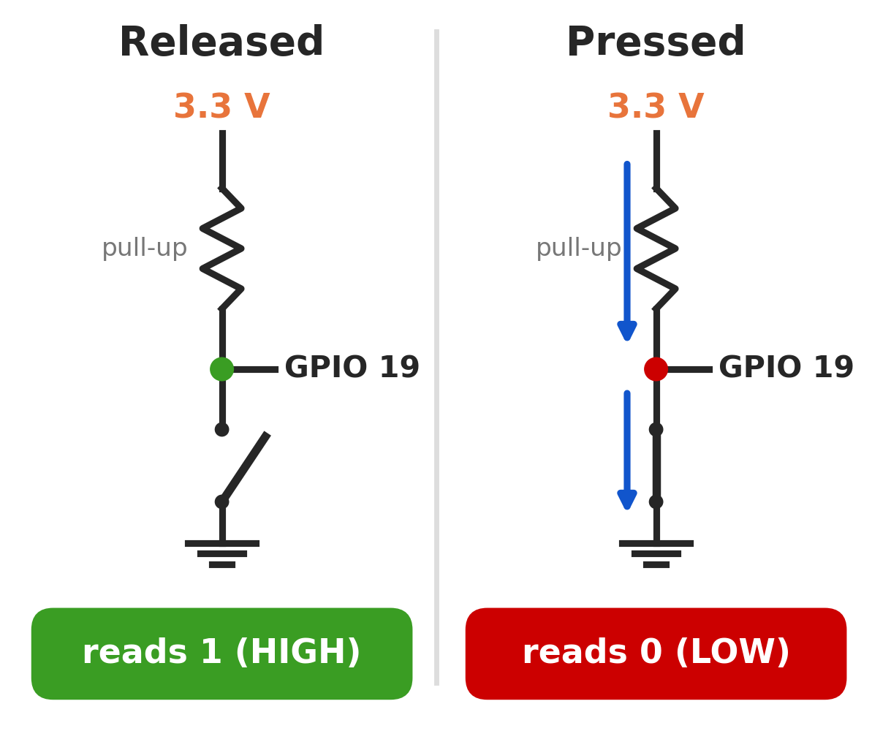
_
x
Why Pull-Up?
_
x
_
x
C:\WINDOWS\system32\cmd.exe
C:\
pull_up.bmp - Paint
Nothing attached
= floating: reads
random 0s and 1s
INPUT_PULLUP
holds it at 1.
Press → GND → 0
File Edit View Image Colors Help
For Help, click Help Topics on the Help Menu.

Slide 29
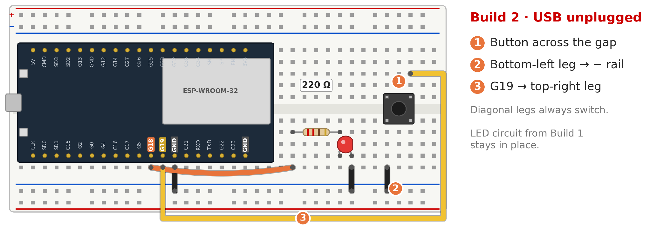
_
x
Build 2: The Button
_
x
build_2.bmp - Paint
File Edit View Image Colors Help
For Help, click Help Topics on the Help Menu.

Slide 30
_
x
Button Code
C:\WINDOWS\system32\cmd.exe
_
x
C:\
const int LED = 18;
const int BTN = 19;
void setup() {
pinMode(LED, OUTPUT);
pinMode(BTN, INPUT_PULLUP); // HIGH until pressed
}
void loop() {
if (digitalRead(BTN) == LOW) { // pressed?
digitalWrite(LED, HIGH);
} else {
digitalWrite(LED, LOW);
}
}

Slide 31
_
x
Talk Back: Serial
C:\WINDOWS\system32\cmd.exe
_
x
C:\
// add inside setup():
Serial.begin(115200);
// add inside loop():
Serial.println(digitalRead(BTN));
Tools → Serial Monitor (115200 baud)
Press the button. What changes? Why?

Slide 32
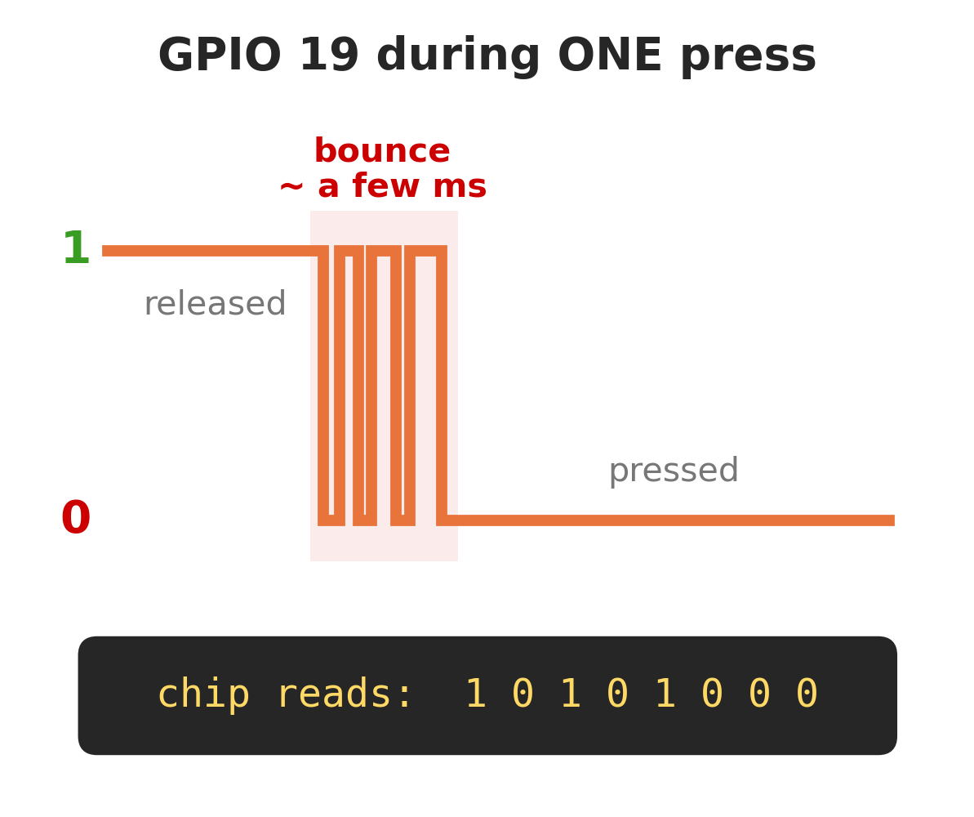
_
x
Buttons Bounce
_
x
_
x
C:\WINDOWS\system32\cmd.exe
C:\
bounce.bmp - Paint
One press looks
like many to
a fast chip.
Fix: after a change,
ignore the pin
for ~50 ms.
File Edit View Image Colors Help
For Help, click Help Topics on the Help Menu.

Slide 33
_
x
https://www.itCompiledFirstTry.com
Level Up
Part 5 of 5 · ~25 min

Slide 34
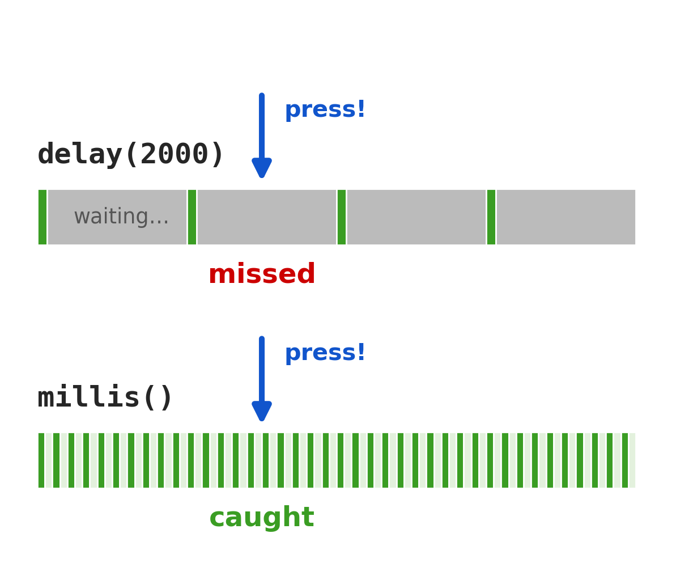
_
x
The delay() Trap
_
x
_
x
delay_trap.bmp - Paint
C:\WINDOWS\system32\cmd.exe
C:\
File Edit View Image Colors Help
Try it:
add delay(2000);
at the end of the
button loop().
Now press it.
delay() blocks
your loop.
For Help, click Help Topics on the Help Menu.

Slide 35
_
x
Non-Blocking Time
C:\WINDOWS\system32\cmd.exe
_
x
C:\
unsigned long last = 0;
bool ledOn = false;
void loop() {
if (millis() - last >= 500) { // 500 ms passed?
last = millis();
ledOn = !ledOn;
digitalWrite(LED, ledOn);
}
// button code here runs every pass!
}

Slide 36
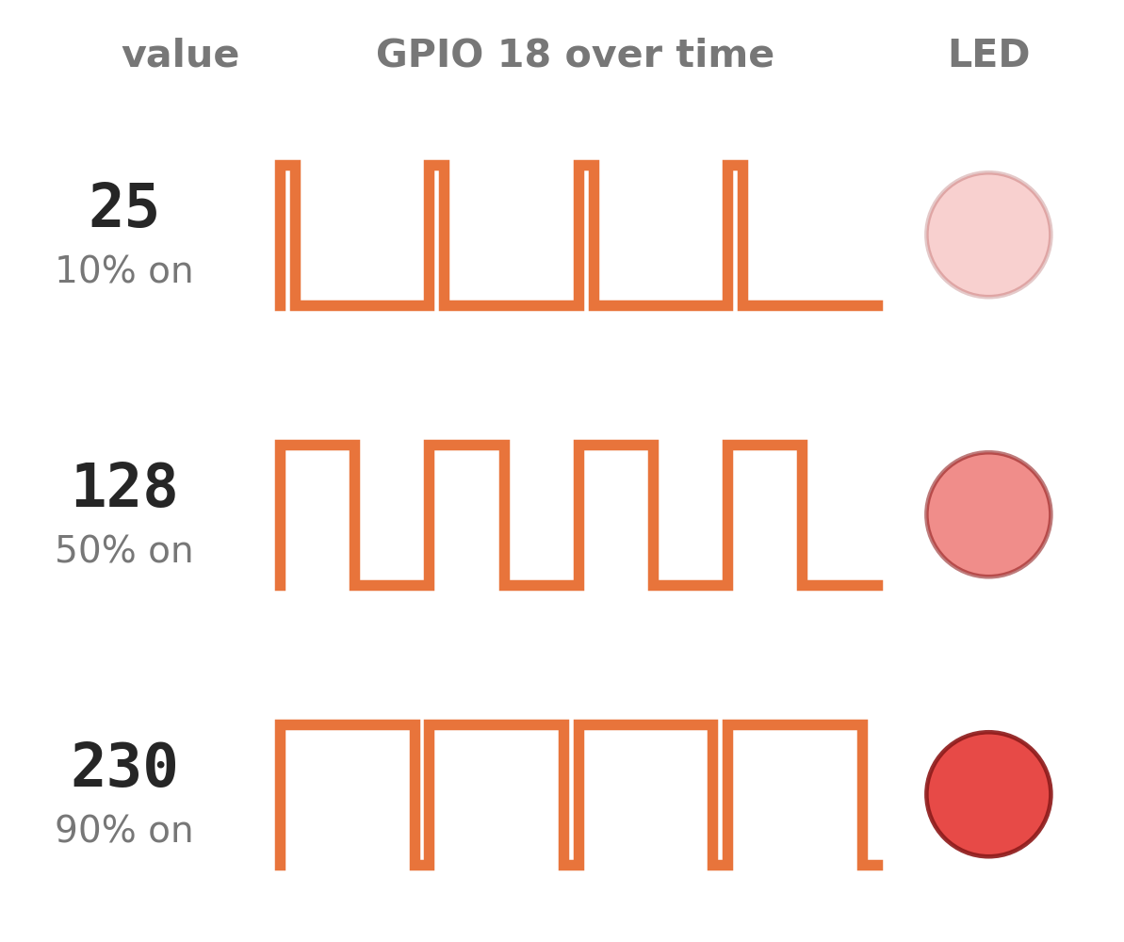
_
x
Fake Analog: PWM
_
x
_
x
C:\WINDOWS\system32\cmd.exe
C:\
pwm.bmp - Paint
analogWrite(18, 0–255)
Pin flips on/off
~1000× per second.
More ON time =
brighter LED.
Works on any
output pin.
File Edit View Image Colors Help
For Help, click Help Topics on the Help Menu.

Slide 37
_
x
Challenge Mode
C:\WINDOWS\system32\cmd.exe
_
x
C:\
LVL 1 Blink SOS in Morse code
LVL 2 Press = on, press again = off
LVL 3 Button changes blink speed
LVL 4 Fade in and out with PWM
BOSS Switch the LED from your phone
BOSS: File → Examples → WiFi → WiFiAccessPoint.
Set LED_BUILTIN to 18, give the network a unique name,
join it on your phone, open the IP it prints (192.168.4.1)
Easy bonus: scan for Wi-Fi (next slide).

Slide 38
_
x
Bonus: Scan for Wi-Fi
C:\WINDOWS\system32\cmd.exe
_
x
C:\
#include <WiFi.h>
void setup() {
Serial.begin(115200);
WiFi.mode(WIFI_STA); // radio on
int n = WiFi.scanNetworks(); // listen
for (int i = 0; i < n; i++) {
Serial.print(WiFi.RSSI(i)); // strength
Serial.print(" ");
Serial.println(WiFi.SSID(i)); // name
}
}
void loop() {}

Slide 39
_
x
Questions?
C:\WINDOWS\system32\cmd.exe
_
x
C:\
Tell us what to build next.

